Slide 1


CSCE 5640 Operating System Design Processes
Dr. Amar Maharjan
Computer Science and Engineering
University of North Texas
Slides (with some modifications) from:
Operating System Concepts – Silberschatz, Galvin and Gagne © 2018

Slide 2
Outline
Process Concept
Process Scheduling
Operations on Processes
Interprocess Communication
IPC in Shared-Memory Systems
IPC in Message-Passing Systems
Examples of IPC Systems
Communication in Client-Server Systems

Slide 3
Process Concept
An operating system executes a variety of programs that run as a process.
Process – a program in execution; process execution must progress in sequential fashion.
No parallel execution of instructions of a single process.
Multiple parts
The program code, also called text section
Stack containing temporary data
Function parameters, return addresses, local variables
Data section containing global variables
Heap containing memory dynamically allocated during run time

Slide 4
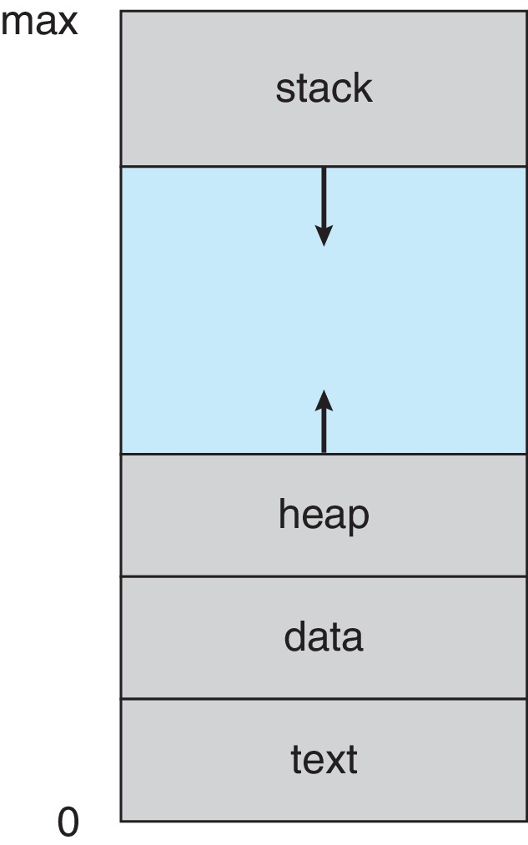
Process Concept (contd.)
Program is passive entity stored on disk (executable file) and process is active
Program becomes process when an executable file is loaded into memory
Execution of program started via GUI mouse clicks, command line entry of its name, etc.
One program can be several processes
Consider multiple users executing the same program
Process layout in memory
Notes:
Text: Code that you write
Heap: Dynamic storage created by malloc, calloc, etc.
Stack: Based on the number of function calls.
Stack and heap can increased based on their use.

Slide 5
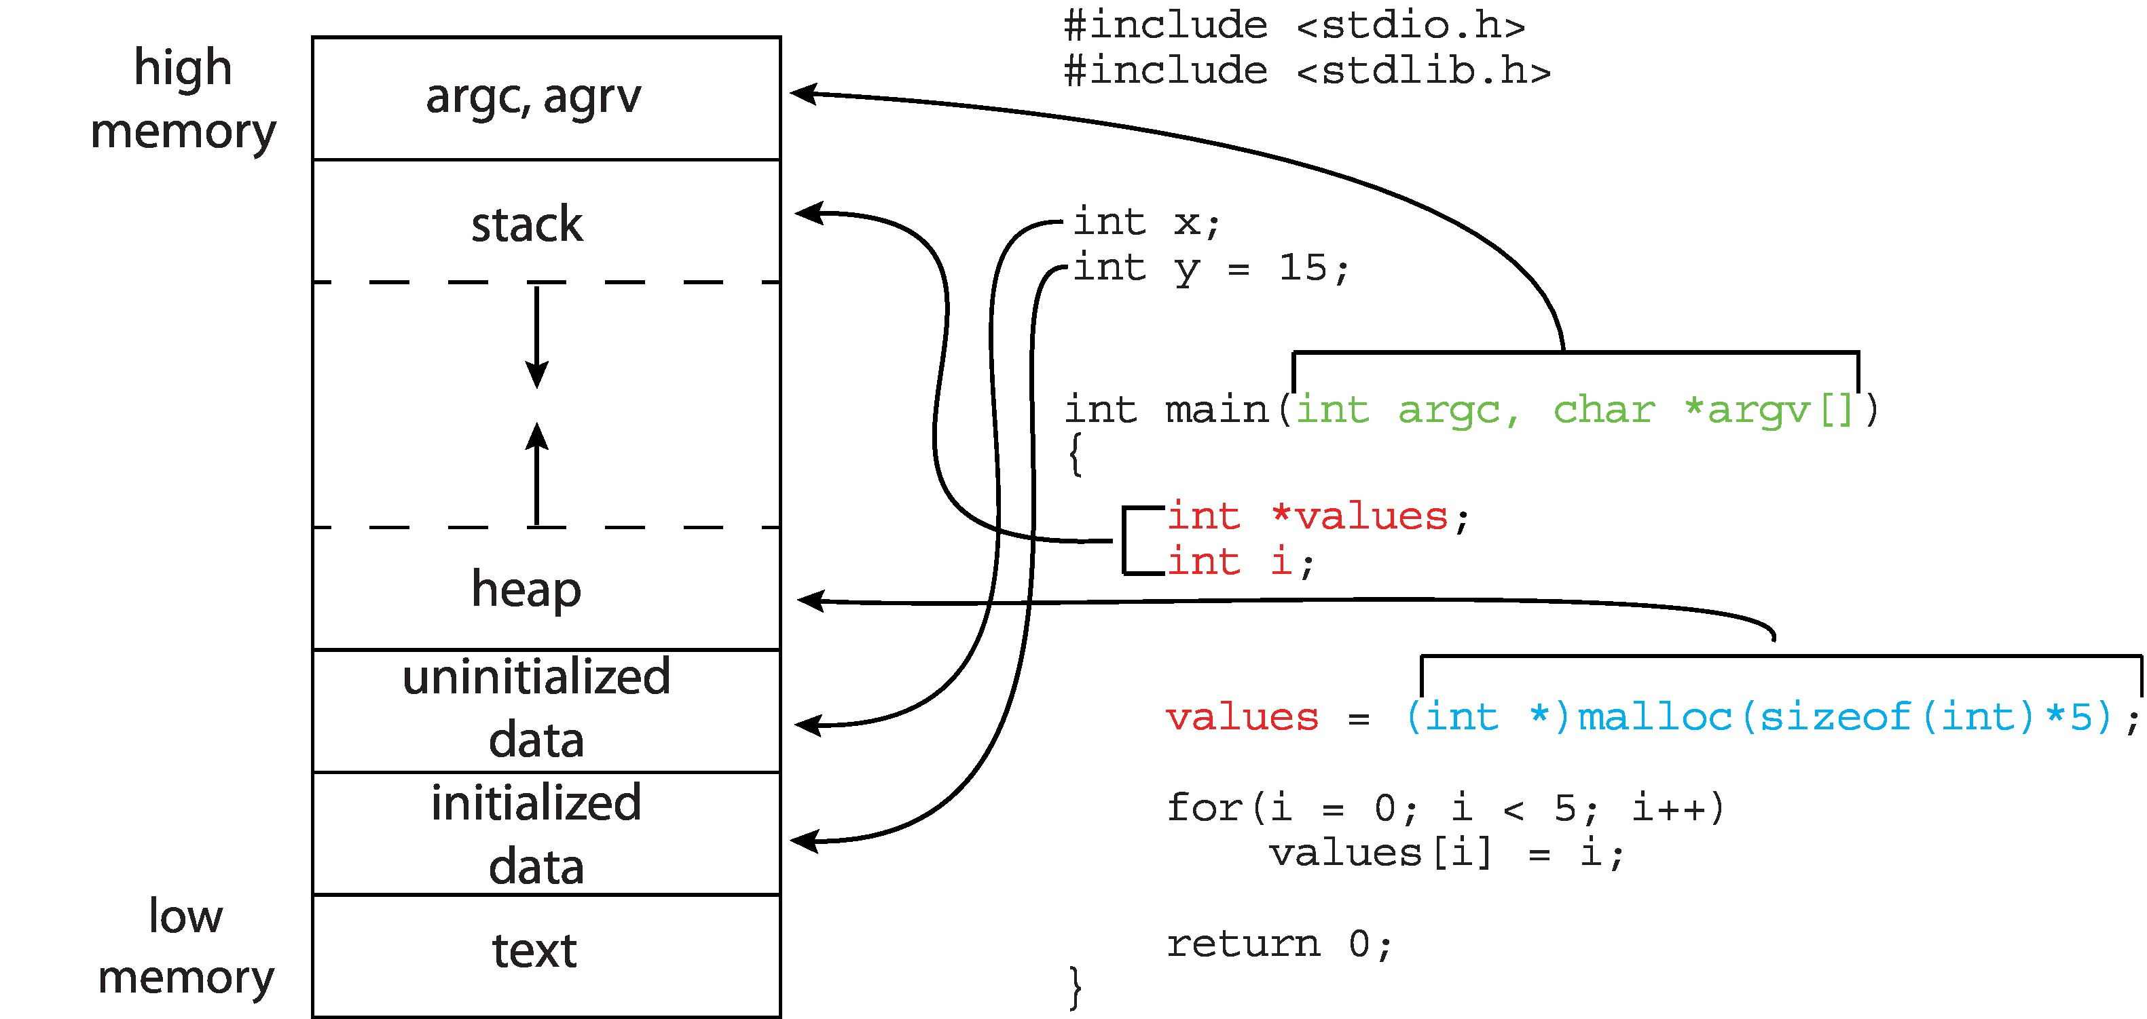
Memory Layout of C Program
$ size main.out
text data bss dec hex filename
1603 604 12 2219 8ab main.out
Notes:
The data field refers to uninitialized data, and bss refers to initialized data.
(bss is a historical term referring to block started by symbol.)
The dec an hex values are the sum of the three sections represented in decimal and hexadecimal, respectively.
Argc – c stands for count
Argv – v stands for vector
In linux we have a command called size which will give the size of all the things in bytes.
Bss : Size of uninitialized data.
Dec: Decimal value
Hex: Hexa

Slide 6
Process State
As a process executes, it changes state.
A process may be in one of the following states:
New: The process is being created
Running: Instructions are being executed
Waiting: The process is waiting for some event to occur
Ready: The process is waiting to be assigned to a processor
Terminated: The process has finished execution
At any instant, only one process can be running on any processor core.
Many processes may be ready and waiting.
Notes:
When we hit ./main there will be a new process created.
OS is responsible for executing the process.

Slide 7
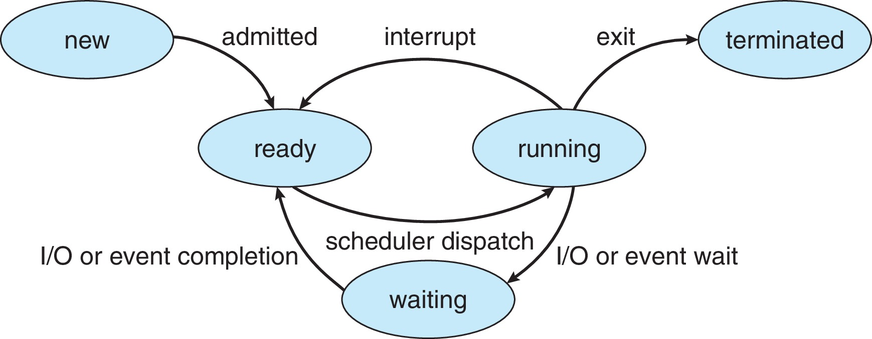
Diagram of Process State

Slide 8
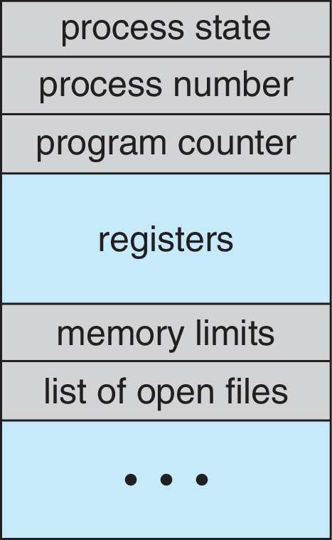
Process Control Block (PCB)
Information associated with each process - also called task control block
Process state – running, waiting, etc.
Program counter – location of instruction to next execute
CPU registers – contents of all process-centric registers
CPU scheduling information- priorities, scheduling queue pointers
Memory-management information – memory allocated to the process
Accounting information – CPU used, clock time elapsed since start, time limits, process number
I/O status information – I/O devices allocated to process, list of open files

Slide 9
Threads
So far, process has a single thread of execution
Perform only one task at a time.
Consider having multiple threads per process
Word processor assign one thread to manage user input while another thread runs the spell checker.
Must then have storage for thread details, multiple program counters in PCB
More detail in Chapter 4

Slide 10
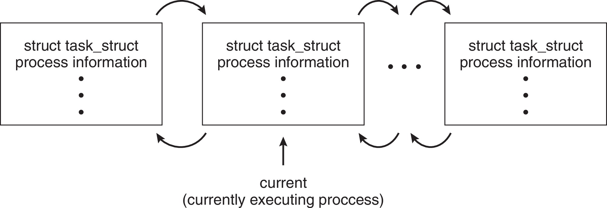
Process Representation in Linux
Represented by the C structure task_struct
<include/linux/sched.h>
long state; /* state of the process */ struct sched_entity se; /* scheduling information */ struct task_struct *parent; /* this process’s parent */ struct list_head children; /* this process’s children */ struct files_struct *files; /* list of open files */ struct mm_struct *mm; /* address space of this process */

Slide 11
Process Scheduling
Process scheduler selects among available processes for next execution on CPU core
Goal -- Maximize CPU use, quickly switch processes onto CPU core
Types of processes:
I/O bound
CPU-bound
Maintains scheduling queues of processes
Ready queue – set of all processes residing in main memory, ready and waiting to execute
Wait queues – set of processes waiting for an event (i.e., I/O)
Processes migrate among the various queues

Slide 12
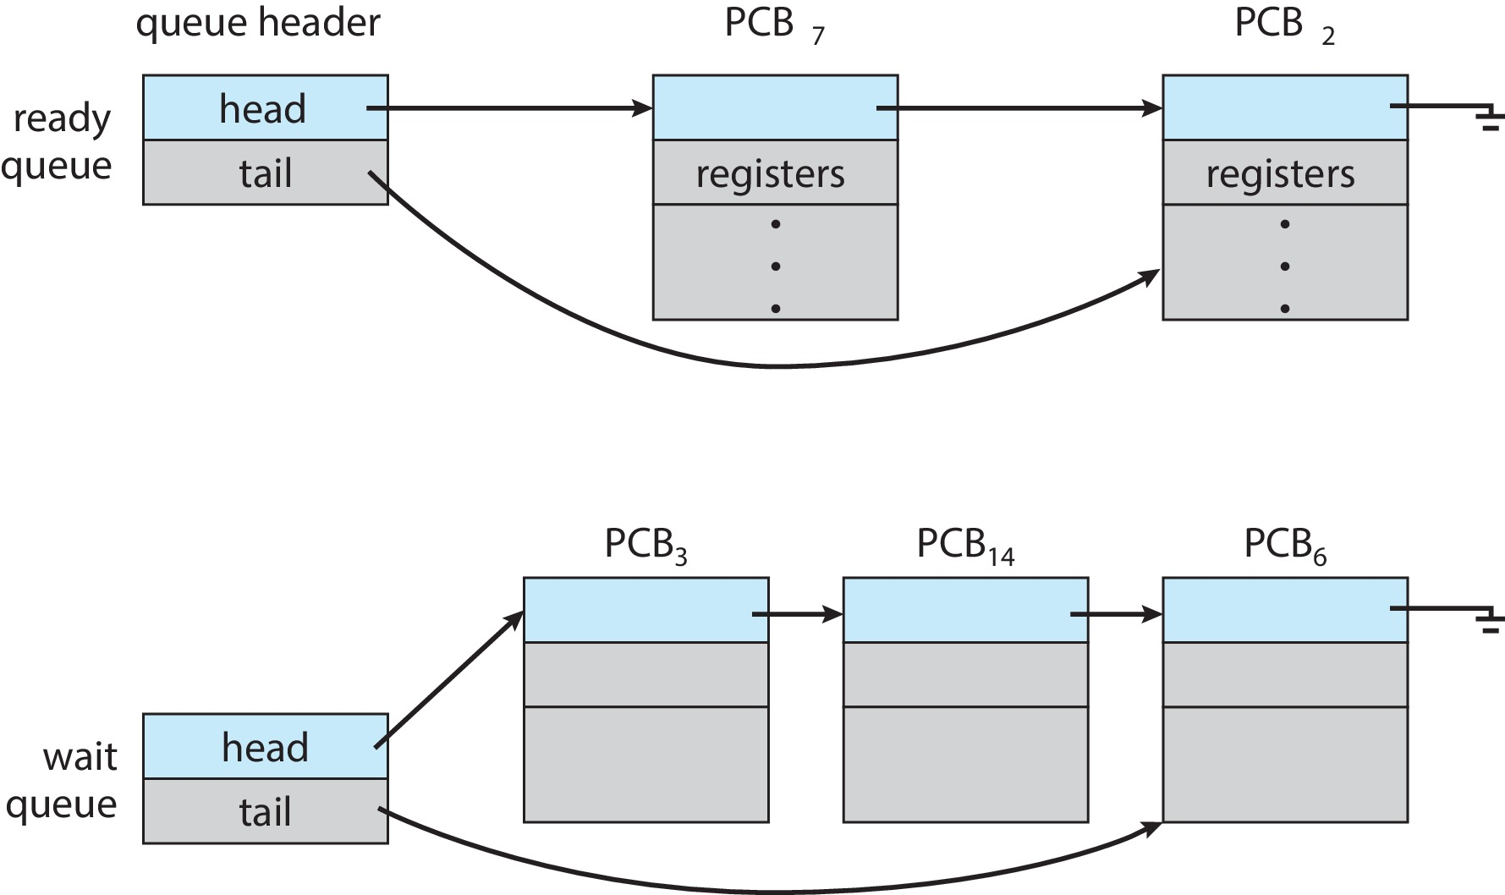
Ready and Wait Queues
Notes:
In the wait queue, the head is necessary, but the tail is not. The tail helps in efficiency, with a tail, we can directly go to the end, if there is no tail, we need to travel all the way to reach the end.

Slide 13
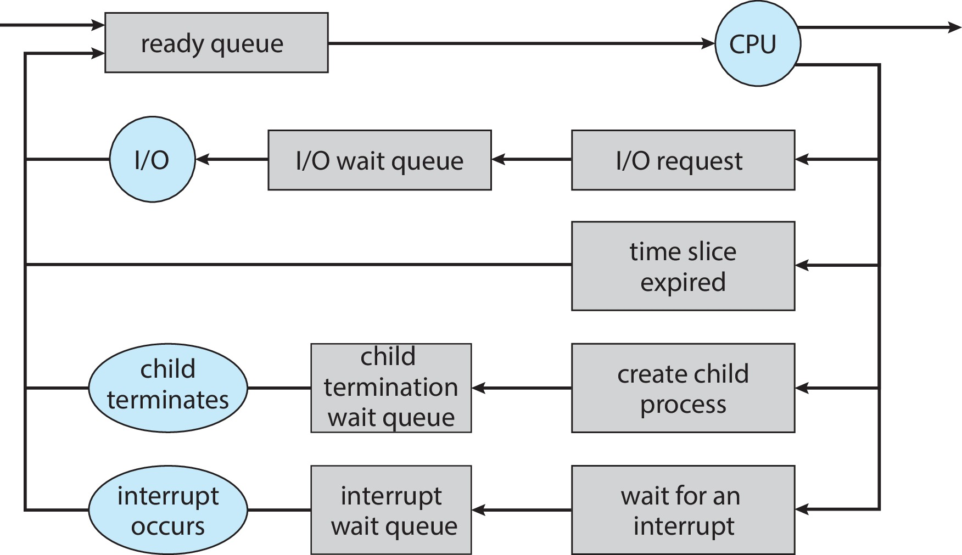
Representation of Process Scheduling
Notes:
Parents might be interested in the child's process results, and that is the reason why the child is also put in the waiting queue.

Slide 14
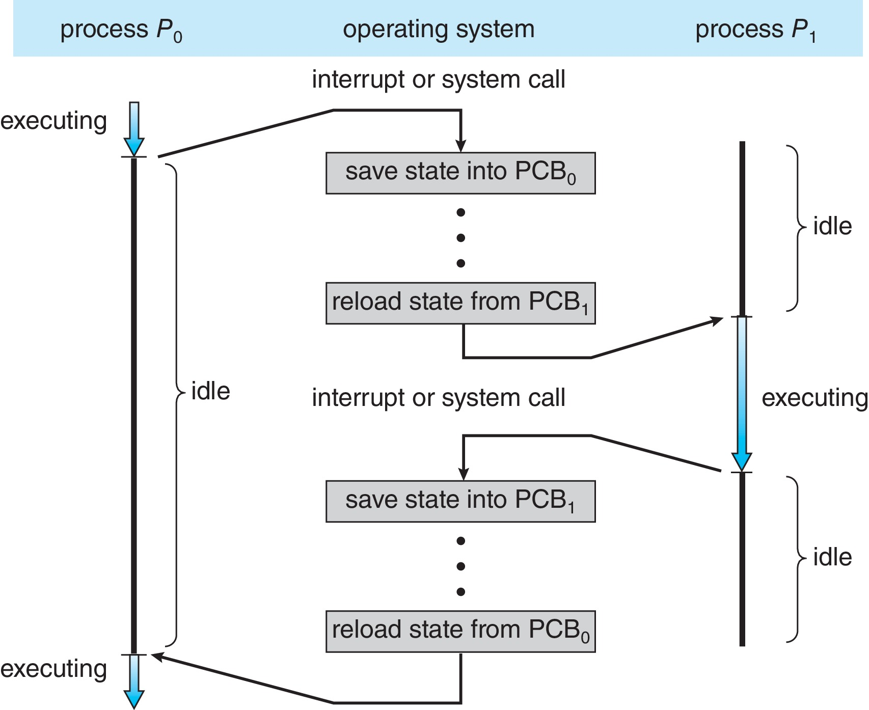
CPU Switch From Process to Process
A context switch occurs when the CPU switches from one process to another.
Notes:
Data is stored in PCB (datatype).

Slide 15
Context Switch
When CPU switches to another process, the system must save the state of the old process and load the saved state for the new process via a context switch
Context of a process represented in the PCB
Context-switch time is pure overhead; the system does no useful work while switching
The more complex the OS and the PCB ➔ the longer the context switch
Time of a context switch is dependent on hardware.
For instance, a context switch here simply requires changing the pointer to the current register set.
More active processes than register sets -> the system resorts to copying register data to and from memory, as before.
Notes:
Context-switch times are highly dependent on hardware support. For instance, some processors provide multiple sets of registers.
A context switch here simply requires changing the pointer to the current register set.
Of course, if there are more active processes than there are register sets, the system resorts to copying register data to and from memory, as before.

Slide 16
Operations on Processes
System must provide mechanisms for:
Process creation
Process termination

Slide 17
Process Creation
Parent process create children processes, which, in turn create other processes, forming a tree of processes
Generally, process identified and managed via a process identifier (pid)
pid is typically an integer number.
Resource sharing options
Parent and children share all resources
Children share subset of parent’s resources
Parent and child share no resources
Execution options
Parent and children execute concurrently
Parent waits until children terminate

Slide 18
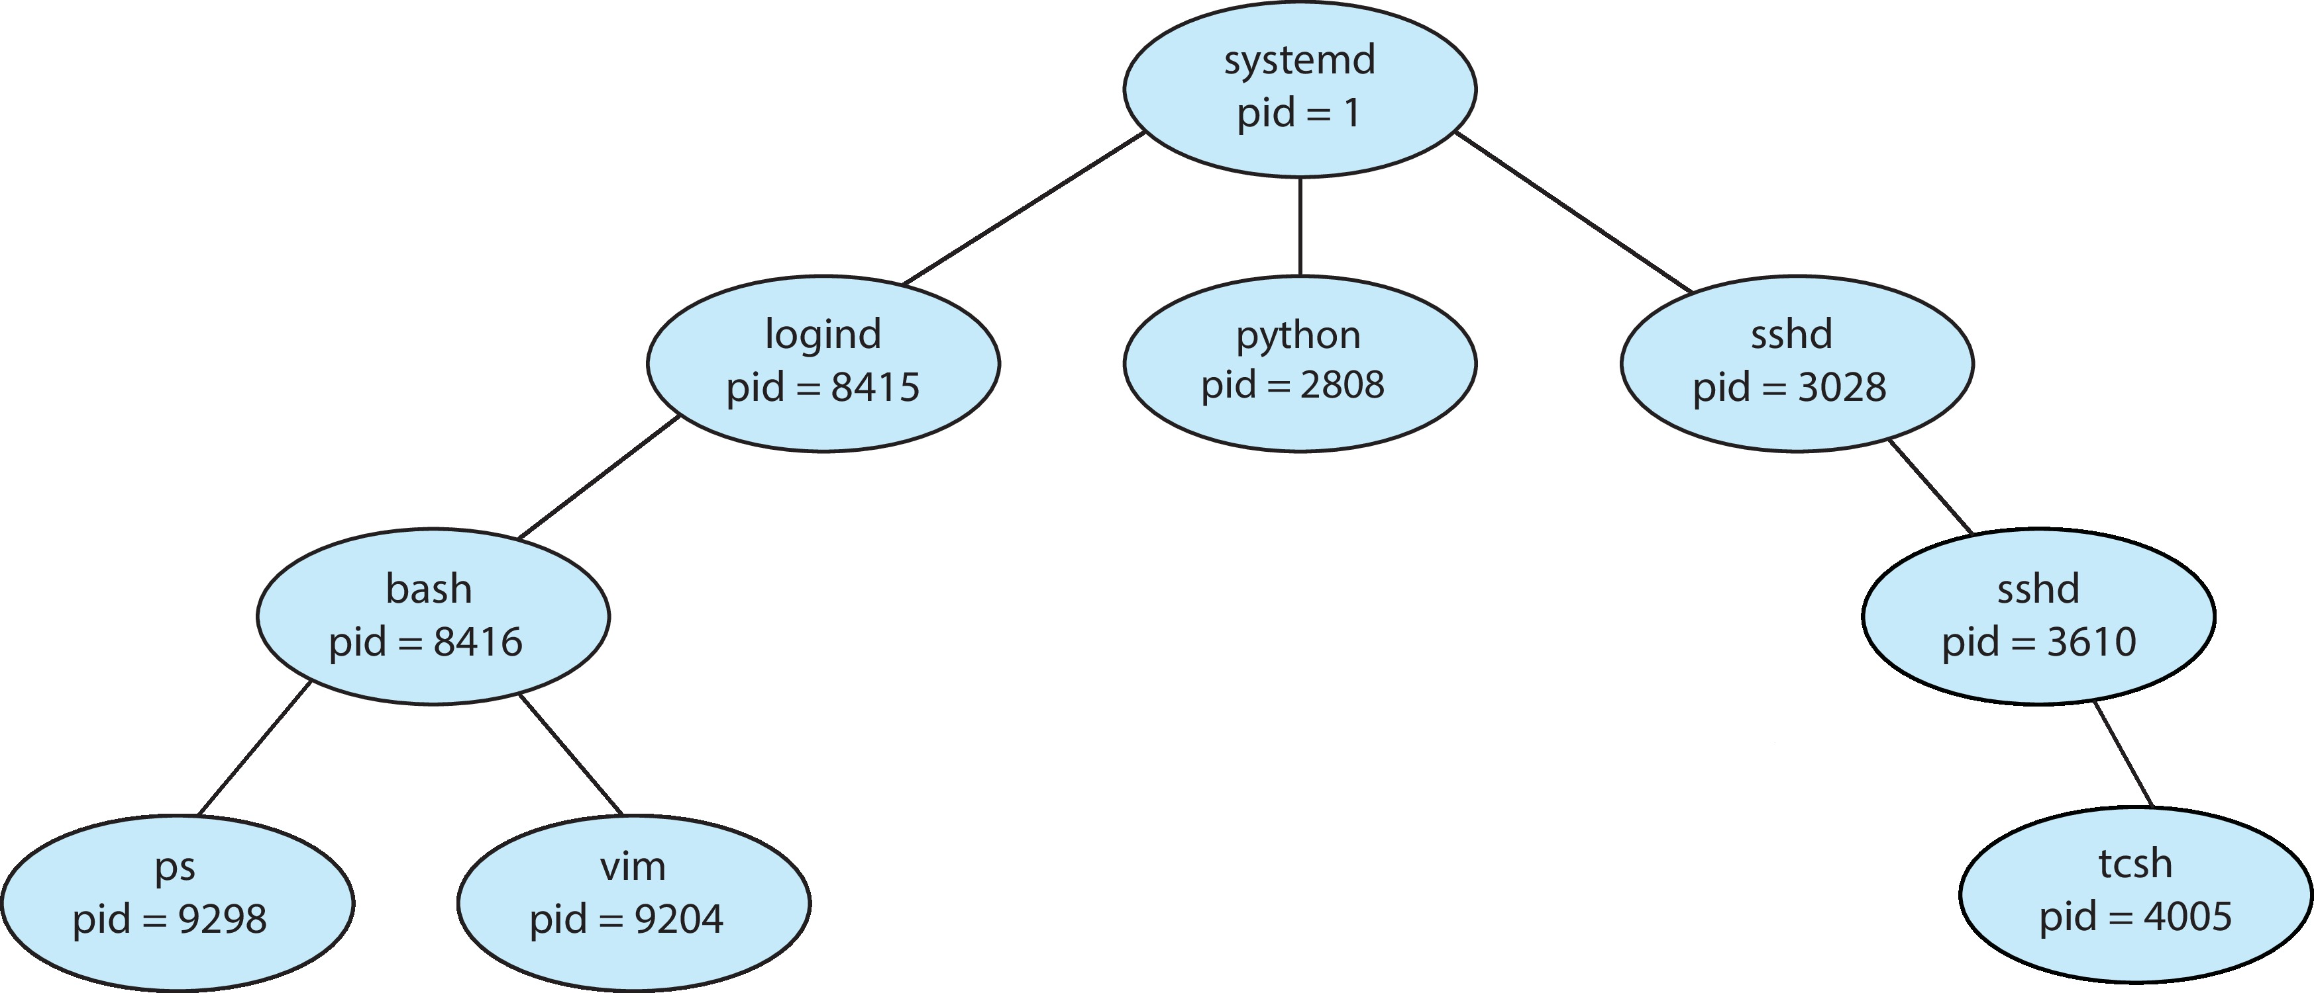
A Tree of Processes in Linux
Notes:
If there is a ‘d’ at the end of the name of the process it’s a demon process.

Slide 19
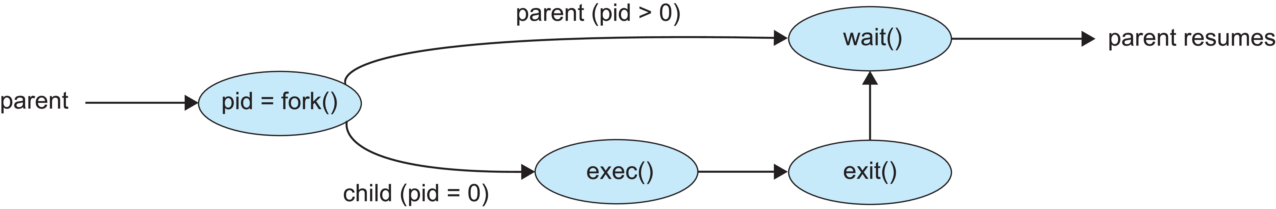
Process Creation (Cont.)
Address space
Child duplicate of parent
Child has a program loaded into it
UNIX examples
fork() system call creates new process
exec() system call used after a fork() to replace the process’ memory space with a new program
Parent process calls wait()waiting for the child to terminate

Slide 20
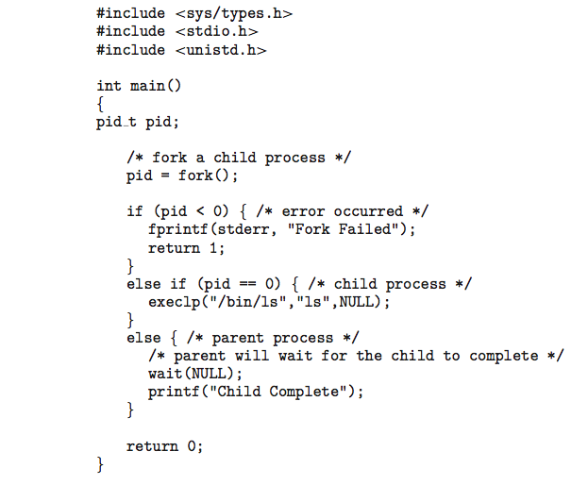
C Program Forking Separate Process
Notes:
fprintf: file printf (Write in file)
Stderr: Printed immediately on the screen.
Stdout: Slower than stderr because it copies.
Return 0: Everything is fine.
Return 1: Some problem has occurred.
Execlp: l(command line list), p(path)
OS maintains path in environmental variable.
Ls: listing in the current path.

Slide 21
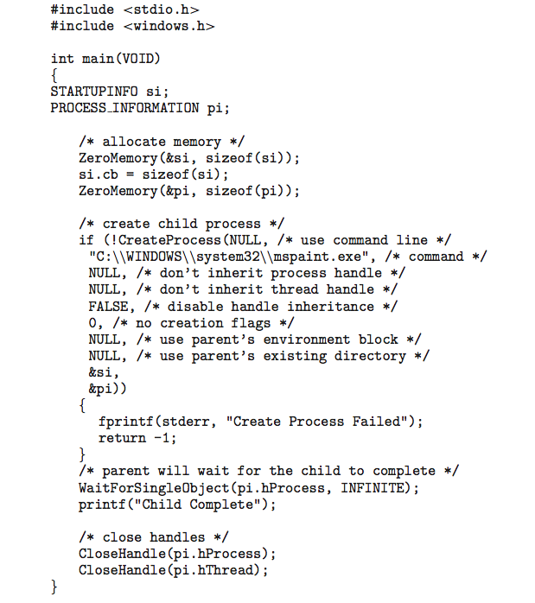
Creating a Separate Process via Windows API
Notes:
Zeromemory: Clean up the memory content.
Loading mspaint GUI.

Slide 22
Process Termination
Process executes last statement and then asks the operating system to delete it using the exit() system call.
Returns status data from child to parent (via wait())
Process’ resources are deallocated by operating system
Parent may terminate the execution of children processes using the abort() (TerminateProcess() in Windows) system call. Some reasons for doing so:
Child has exceeded allocated resources
Task assigned to child is no longer required
The parent is exiting, and the operating systems does not allow a child to continue if its parent terminates
Notes:
Two ways of terminating – exit system call, parent can terminate to terminate the child processes.

Slide 23
Process Termination
In some OS: If a process terminates, then all its children must also be terminated.
cascading termination. All children, grandchildren, etc., are terminated.
The termination is initiated by the operating system.
The parent process may wait for termination of a child process by using the wait()system call.
The call returns status information and the pid of the terminated process
pid_t pid;
int status;
pid = wait(&status);
If no parent waiting (did not invoke wait()), process is a zombie
If parent terminated without invoking wait(), process is an orphan
Notes:
Cascading: Propagation (Ex: Parent is terminating child process).
pid (Process ID of the process that is terminated).
Basically, zombie and orphan processes will be reclaimed by the OS after some time (after a few seconds).

Slide 24
Interprocess Communication
Processes within a system may be independent or cooperating
Cooperating process can affect or be affected by other processes, including sharing data
Reasons for cooperating processes:
Information sharing (eg: copying and pasting)
Computation speedup (break a task into multiple tasks and run them parallelly)
Modularity (dividing the system functions into separate processes or threads)
Cooperating processes need interprocess communication (IPC)
Two fundamental models of IPC
Shared memory
Message passing
Notes:
Big task is divided into small tasks and, they communicate to solve the big problem.

Slide 25
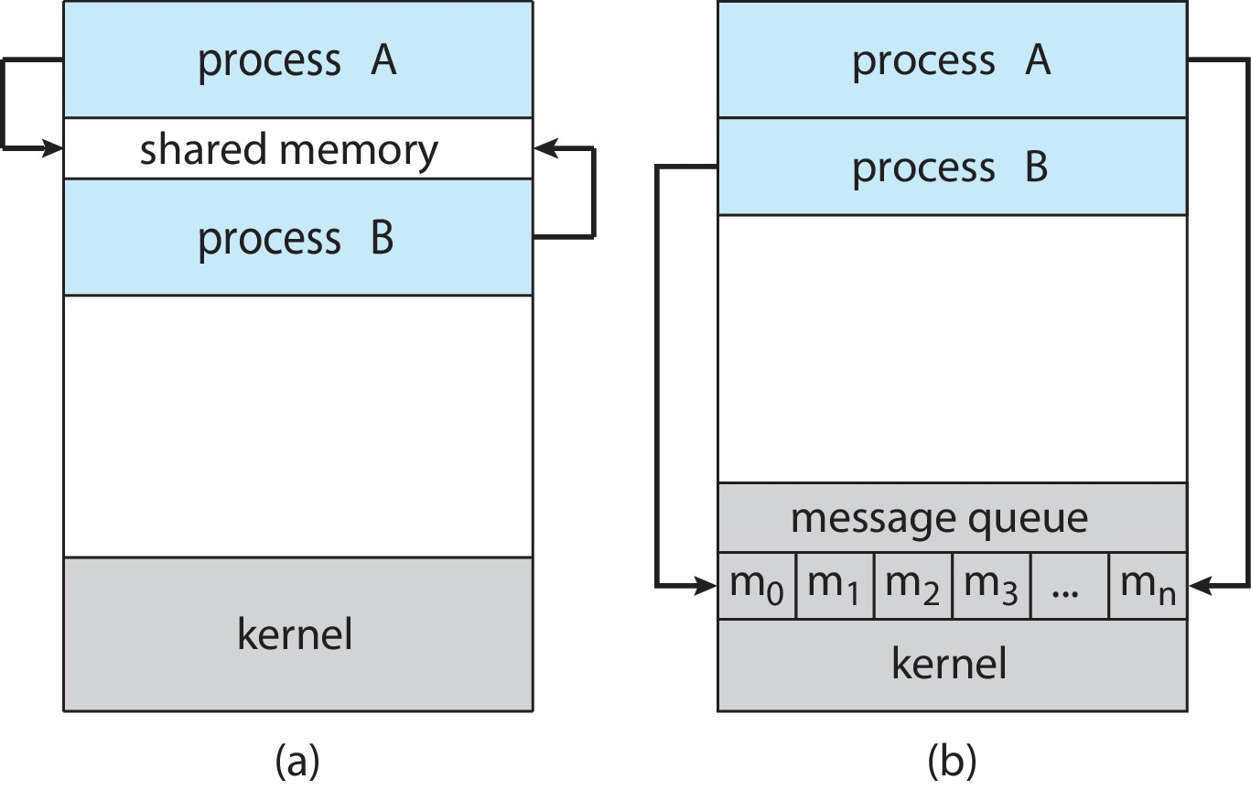
Communications Models
(a) Shared memory. (b) Message passing.
Notes:
In message passing, the communication happens via OS.
If A wants to send a message to B, it is done by the OS kernel, that is the reason why message passing is slower than shared memory.
In shared memory we call system call only one to create a shared memory. One more system call maybe required to delete/clear the memory.

Slide 26
IPC – Shared Memory
An area of memory shared among the processes that wish to communicate
The communication is under the control of the users processes not the operating system.
Major issues is to provide mechanism that will allow the user processes to synchronize their actions when they access shared memory.
Notes:
In shared memory, we need to have some synchronization methods because if one process is reading and another process is writing, then that’s a problem.

Slide 27
Producer-Consumer Problem
Paradigm for cooperating processes:
producer process produces information that is consumed by a consumer process
Two variations:
unbounded-buffer places no practical limit on the size of the buffer:
Producer never waits
Consumer waits if there is no buffer to consume
bounded-buffer assumes that there is a fixed buffer size
Producer must wait if all buffers are full
Consumer waits if there is no buffer to consume
Notes:
Producer (Parent): Produce data and store it in the memory/buffer.
If the buffer is full, the producer must wait for the consumer to consume.
Consumer (Child): Consumes the data stored in the memory.
If the buffer is empty, the consumer should wait.

Slide 28
Bounded-Buffer – Shared-Memory Solution
Shared data
#define BUFFER_SIZE 10
typedef struct {
. . .
} item;
item buffer[BUFFER_SIZE];
int in = 0;
int out = 0;
Solution is correct, but can only use BUFFER_SIZE-1 elements
Notes:
You can store a maximum of 9 elements if we use this in-and-out technique.

Slide 29
Producer Process – Shared Memory
item next_produced;
while (true) {
/* produce an item in next produced */
while (((in + 1) % BUFFER_SIZE) == out)
; /* do nothing */
buffer[in] = next_produced;
in = (in + 1) % BUFFER_SIZE;
}
Notes:
The inner while loop makes sure that if the buffer is full, the producer should wait for the consumer to consume the data.
This will work, but implementation-wise, this is not the perfect solution.

Slide 30
Consumer Process – Shared Memory
item next_consumed;
while (true) {
while (in == out)
; /* do nothing */
next_consumed = buffer[out];
out = (out + 1) % BUFFER_SIZE;
/* consume the item in next consumed */
}
Notes:
In Chapter 6 and Chapter 7, we discuss how synchronization among cooperating processes can be implemented effectively in a shared-memory environment.

Slide 31
What about Filling all the Buffers?
Suppose that we wanted to provide a solution to the consumer-producer problem that fills all the buffers.
We can do so by having an integer counter that keeps track of the number of full buffers.
Initially, counter is set to 0.
The integer counter is incremented by the producer after it produces a new buffer.
The integer counter is decremented by the consumer after it consumes a buffer.
Notes:
Previously, the buffer size was ten, but we were able to store only nine elements, so to solve this, the author used a counter instead of in-and-out.

Slide 32
Producer
while (true) { /* produce an item in next produced */
while (counter == BUFFER_SIZE)
; /* do nothing */
buffer[in] = next_produced;
in = (in + 1) % BUFFER_SIZE;
counter++;
}

Slide 33
Consumer
while (true) {
while (counter == 0)
; /* do nothing */
next_consumed = buffer[out];
out = (out + 1) % BUFFER_SIZE;
counter--;
/* consume the item in next consumed */
}

Slide 34
IPC – Message Passing
Processes communicate with each other without resorting to shared variables
IPC facility provides two operations:
send(message)
receive(message)
The message size is either fixed or variable
Notes:
If only fixed-sized messages can be sent, the system-level implementation is straightforward. This restriction, however, makes the task of programming more difficult.
Conversely, variable-sized messages require a more complex system-level implementation, but the programming task becomes simpler.
This is a common kind of tradeoff seen throughout operating-system design.

Slide 35
Message Passing (contd.)
If processes P and Q wish to communicate, they need to:
Establish a communication link between them
Exchange messages via send/receive
Logical implementation of a communication link and the send()/receive() operations:
Direct or indirect communication
Synchronous or asynchronous communication
Automatic or explicit buffering
Notes:
This communication link is internally provided by the OS.

Slide 36
Direct Communication
Processes must name each other explicitly:
send (P, message) – send a message to process P
receive(Q, message) – receive a message from process Q
Properties of communication link
Links are established automatically
A link is associated with exactly one pair of communicating processes
Between each pair there exists exactly one link
The link may be unidirectional, but is usually bi-directional

Slide 37
Indirect Communication
Messages are directed and received from mailboxes (also referred to as ports)
Each mailbox has a unique id
Processes can communicate only if they share a mailbox
Properties of communication link
Link established only if processes share a common mailbox
A link may be associated with many processes
Each pair of processes may share several communication links
Link may be unidirectional or bi-directional
Notes:
The mailbox must be explicitly created by a process in an indirect communication.

Slide 38
Indirect Communication (contd.)
Operations
Create a new mailbox (port)
Send and receive messages through mailbox
Delete a mailbox
Primitives are defined as:
send(A, message) – send a message to mailbox A
receive(A, message) – receive a message from mailbox A
Notes:
Whoever created this mailbox will receive this message.

Slide 39
Indirect Communication (contd.)
Mailbox sharing
P₁, P₂, and P₃ share mailbox A
P₁, sends; P₂ and P₃ receive
Who gets the message?
Solutions
Allow a link to be associated with at most two processes
Allow only one process at a time to execute a receive operation
Allow the system to select arbitrarily the receiver.
May define an algorithm for selecting which process will receive message (eg: round robin)
Sender is notified who the receiver was.
Notes:
Who gets the message? – Depends on the implementation. So, in case both can get, or one process can be allowed to received (Whoever calls 1st that process will receive) or let OS decide who will get it.

Slide 40
Synchronization
Message passing may be either blocking or non-blocking
Blocking is considered synchronous
Blocking send -- the sender is blocked until the message is received
Blocking receive -- the receiver is blocked until a message is available
Non-blocking is considered asynchronous
Non-blocking send -- the sender sends the message and continue
Non-blocking receive -- the receiver receives:
A valid message, or
Null message
Different combinations possible
If both send and receive are blocking, we have a rendezvous
Notes:
Blocking: One process is sending a message, and receiving must be received at the same time.
Non-blocking: The sender will send, and that’s it, no one will wait. The message is stored in the queue, and the receiver will take it from the queue.

Slide 41
Producer-Consumer: Message Passing
Producer
message next_produced;
while (true) { /* produce an item in next_produced */
send(next_produced);
}
Consumer
message next_consumed;
while (true) { receive(next_consumed) /* consume the item in next_consumed */ }
Notes:
This code looks simpler because it does not have anything like an in, out counter, etc.
This is synchronous. Until the receiver receives the message, the sender will wait.

Slide 42
Buffering
Queue of messages attached to the link.
Implemented in one of three ways
Zero capacity – no messages are queued on a link.
Sender must wait for receiver (rendezvous)
Bounded capacity – finite length of n messages
Sender must wait if link full
Unbounded capacity – infinite length
Sender never waits
Notes:
Zero capacity: No space to keep the data. So, the receiver must receive when the sender is sending, or the sender must wait. This is synchronous.

Slide 43
Examples of IPC Systems - POSIX
POSIX API – shared memory
Mach OS – message passing
Windows API – shared memory/message passing
UNIX - pipes
Notes:
The pipe is also one type of IPC (Inter-process communication)

Slide 44
POSIX Shared Memory
Organized using memory-mapped files – associate the region of shared memory with a file.
A process must create a shared-memory object
shm_fd = shm_open(name, O_CREAT | O_RDWR, 0666);
Also used to open an existing segment
Set the size of the object
ftruncate(shm_fd, 4096);
Use mmap()to memory-map a file pointer to the shared memory object
Reading and writing to shared memory is done by using the pointer returned by mmap().
Notes:
Trying to create a shared memory, and this memory will be mapped to the memory whenever we read or write in the local memory, which will be reflected in the shared memory. We will use pointers to map.
shm_fd = shm_open(name, O_CREAT | O_RDWR, 0666): I want to create a shared memory with the name which I want to create and read.
ftruncate(shm_fd, 4096); Create a file of that size – 4096 bytes in that shared memory.

Slide 45
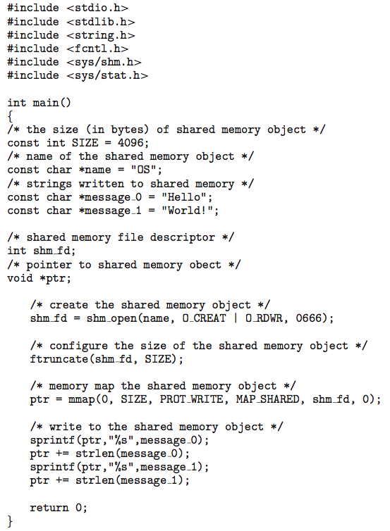
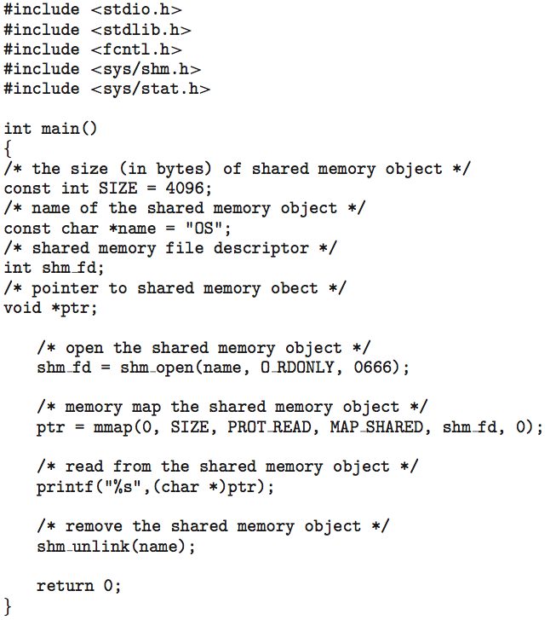
IPC POSIX Producer-Consumer
Notes:
Move the pointer to the length of the message, or else we will be overwriting the message.
In C and C++, the string always ends with a null pointer.
The left code is written in the shared memory.
The right code is read from the shared memory.
1st, we need to execute the producer and then the consumer.

Slide 46
Mach Message Passing
Mach was especially designed for distributed systems.
But was shown to be suitable for desktop and mobile systems (eg: macOS, iOS).
Mach communication is message based
Even system calls are messages, send to and received from – mailboxes or ports.
Each task gets two ports at creation - Kernel and Notify
Messages are sent and received using the mach_msg() function
Ports needed for communication, created via
mach_port_allocate()
Send and receive are flexible; for example, four options if mailbox full:
Wait indefinitely
Wait at most n milliseconds
Return immediately
Temporarily cache a message
Notes:
We need to create a mailbox or port number.
Whenever we want to send a message, we send it to that port number.
Task and process can be used interchangeably.
Kernal port is acquired by the kernel or OS.

Slide 47
Message Passing in Mach
#include<mach/mach.h>
struct message { mach_msg_header_t header;
int data;
}; mach_port_t client;
mach_port_t server;
Notes:
The header must contain who is the sender and who is the receiver, and that kind of information.

Slide 48
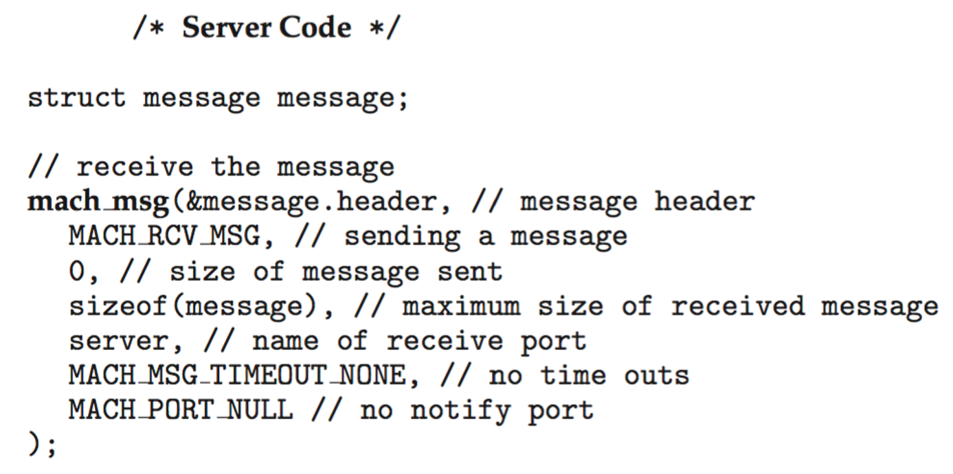
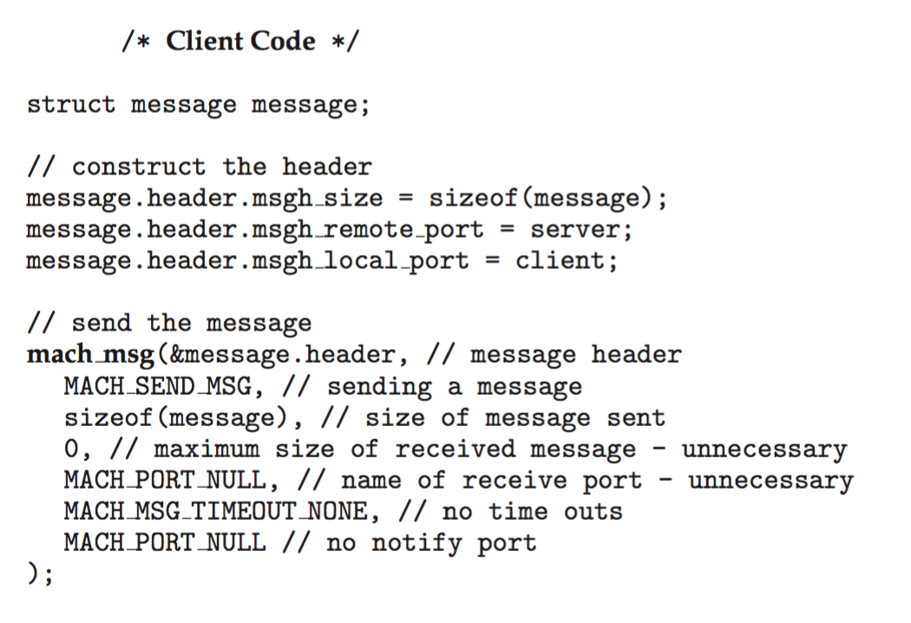
Mach Message Passing – Client/Server
Notes:
MACH_SEND_MSG: Indicates that this message is sending the message.
MACH_RCV_MSG: Indicates that this message is receiving the message.

Slide 49
Examples of IPC Systems – Windows
Message-passing centric via advanced local procedure call (ALPC) facility
Only works between processes on the same system
Uses ports (like mailboxes) to establish and maintain communication channels
Communication works as follows:
The client opens a handle to the subsystem’s connection port object.
The client sends a connection request.
The server creates two private communication ports and returns the handle to one of them to the client.
The client and server use the corresponding port handle to send messages or callbacks and to listen for replies.
Notes:
Hybrid: Shared memory + Message Passing
Works only in the same system, it cannot send messages from one system to other systems.

Slide 50
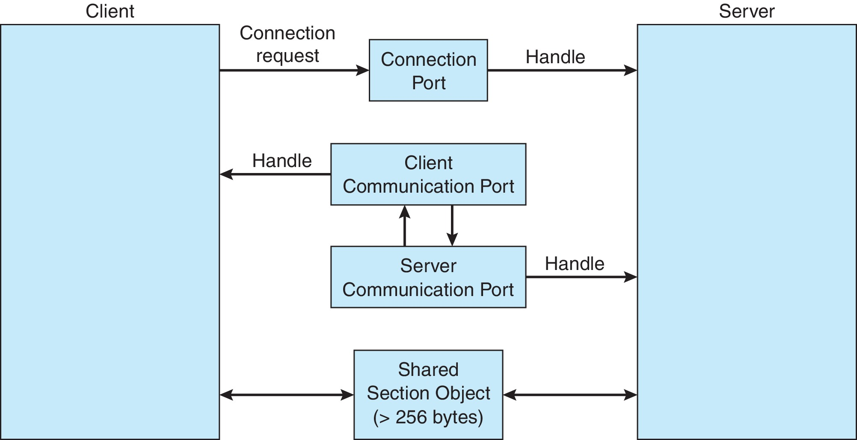
ALPC in Windows
Notes:
1st we create ports and use that ports to send and recieve messages.
This message passing communication is only used if the message size is 256bytes
If it is more then it uses shared memory.

Slide 51
Pipes
Acts as a conduit allowing two processes to communicate
Issues:
Is communication unidirectional or bidirectional?
In the case of two-way communication, is it half or full-duplex?
Must there exist a relationship (i.e., parent-child) between the communicating processes?
Can the pipes be used over a network?
Ordinary pipes – cannot be accessed from outside the process that created it. Typically, a parent process creates a pipe and uses it to communicate with a child process that it created.
Named pipes – can be accessed without a parent-child relationship.
Notes:
half duplex (data can travel only one way at a time) or full duplex (data can travel in both directions at the same time).
Pipes allow to send message Hammond different messages. The process may not be parent-child.

Slide 52
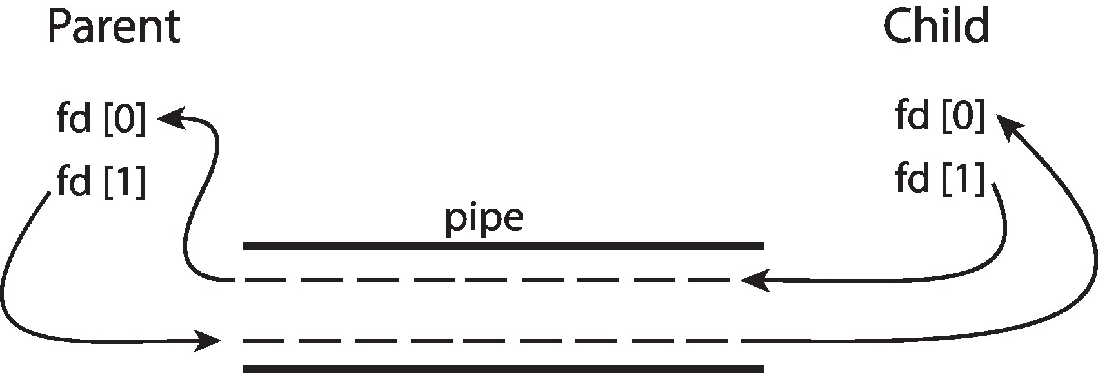
Ordinary Pipes
Ordinary Pipes allow communication in standard producer-consumer style
Producer writes to one end (the write-end of the pipe)
Consumer reads from the other end (the read-end of the pipe)
Ordinary pipes are therefore unidirectional
Require parent-child relationship between communicating processes
Windows calls these anonymous pipes

Slide 53
Named Pipes
Named Pipes are more powerful than ordinary pipes
Communication is bidirectional
No parent-child relationship is necessary between the communicating processes
Several processes can use the named pipe for communication
Provided on both UNIX and Windows systems
Further readings/practices:
Creating ordinary pipes code (UNIX): Figure 3.21 and 3.22
Anonymous pipes (Windows): Figure 3.23, 3.24 and 3.25

Slide 54
Further Readings
3.8 Communications in Client-Server Systems
Remote Procedure Calls (RPCs)
Practice Exercises
Programming Problems/Projects
Notes:
Remote Procedure Calls: Write the code in your system IDE, and that can be executed in the CSCE machine.

